Slide 1


Energy Agencies – Their Role in Leading the Energy Transition
SEAMUS HOYNE, Secretary General FEDARENE
Dean, Technological University of the Shannon
22nd May 2024

Slide 2

About me
  Chair of the Board of Tipperary Energy Agency (CLG)
  Established the Agency in 1998 and was CEO until 2012.
  Now working in Technological University of the Shannon – leading Sustainability and Industry Engagement
  Secretary General of FEDARENE since 2018
  Mechanical Engineer with a passion for innovation and responding to regional opportunities
  Father of 4, married to Aileen and currently completing a Doctorate on Sustainability Leadership in Higher Education

Slide 3

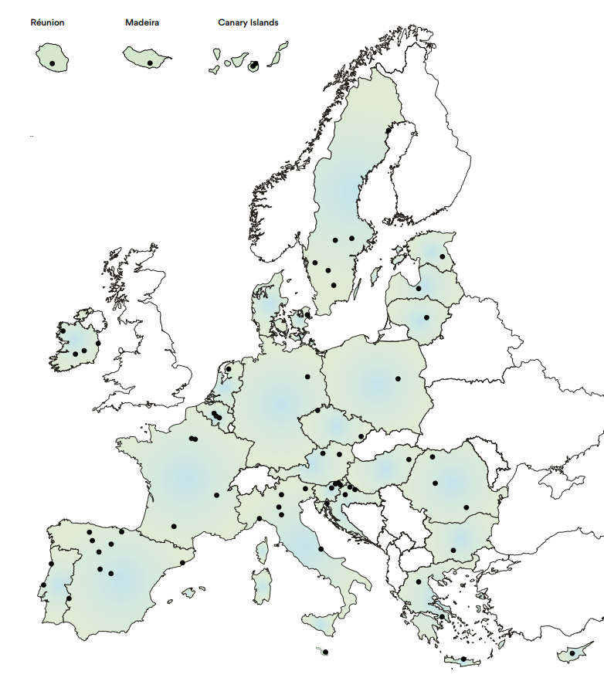
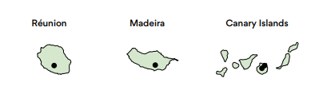



FEDARENE MEMBERS
+80 members
24 European countries
+900 experts
PRESENTATION 2024 — EUFORES

Slide 4

Energy agencies across Europe

Slide 5

The Energy Agency Workforce
2554 / 2017: 1653
total staff of agencies participating in the survey
17 / 2017: 11
average staff of agencies participating in the survey
3600 - 4000 / 2017: 2400-2800
total work workforce local/regional energy agencies

Slide 6
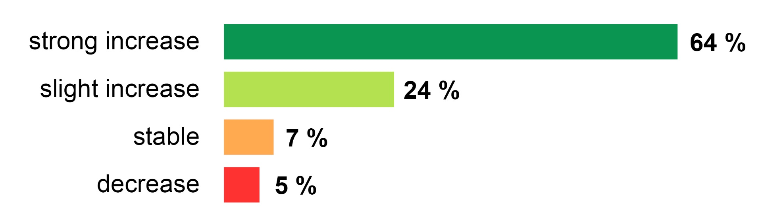
In the past year, how did the overall demand for the services of your agency develop?
88 % of the agencies report an increase in demand of their services.

Slide 7
What changed the most for your agency (open question)?
Increase of activities
New topics
Changes in structures
Increase in activities (82 mentions, 49 % of all EAs): more demand, more projects, more staff, more funding
New topics (56 mentions):
- renewables (especially PV), RECs
- climate mitigation and (some) climate adaptation
- higher complexity/level of details in advice
- management of funds

Slide 8
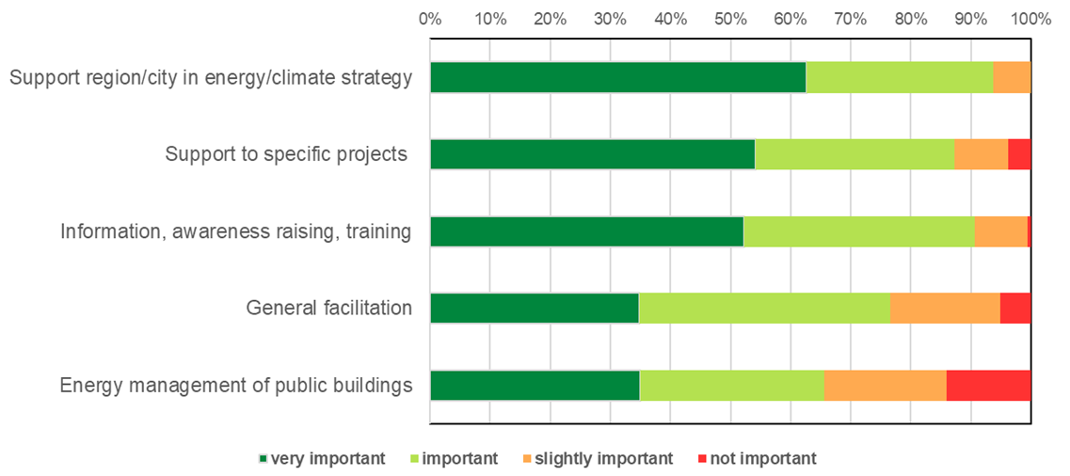
How important are the following activities for your agency?
94 % consider the support to their region/city as a key activity,
91 % information/training and 87 % support to specific projects
Other important activities include stakeholder networks and energy planning

Slide 9
Which is the most important activity of your agency (open question)?
Working on specific projects or city/regional programmes (in total, 115 mentions)
is by far the most important activity.
Facilitation/energy advice
Energy strategy (development/implementation)
Information/awareness raising
Energy management of public buildings
Education/training

Slide 10

THE ENERGY AGENCY FACILITATION MODEL
Market facilitators with public mandates (non-profit, product independent, staying power)
Technical assistance providers for the public and private sectors
Ability to connect stakeholders and governance levels
Regional competence centers for heating and buildings (policy, funding/financing, technology, economic aspects, value chains)
Experiences in structuring financing models with multiple funding streams

Slide 11
Examples of Impact

Slide 12

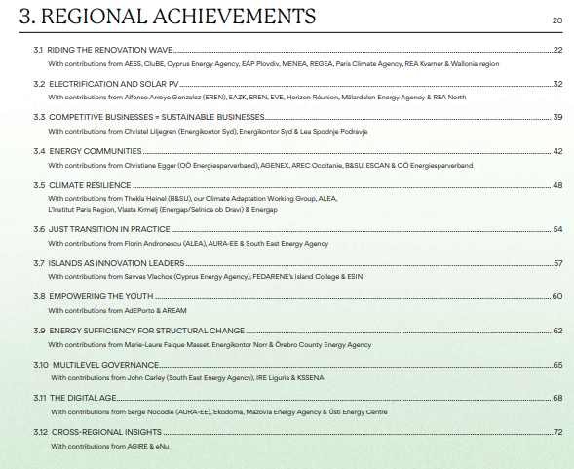
Leading by example across Europe
Deep experience and applied knowledge of delivering the energy transition
Experienced success (and failure) through innovation and implementation
Beyond energy efficiency – renewables, circular economy, adaptation, just transition, energy poverty, digital tools, enterprise/SMEs, energy communities, islands, governance, youth…..and much more

Slide 13
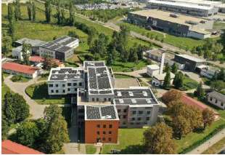
Best practice 1 (Croatia)
City of Zagreb implementing a comprehensive renovation programme of public buildings.
Utilising EU funds (EU LIFE, ELENA) to transform buildings, improve services and integrate renewables (PV)
LIFE CROSS: 100 buildings, 20 MW PV, €67m investment triggered
ELENA ZA GREEN: 50 buildings, €80m investment, BMS
ELENA PVMax: €70m investment across residential/public buildings
PRESENTATION 2024 — EUFORES

Slide 14


Emerging Innovations (Ireland)
TRESS (Transforming Renovation in the Atlantic Seaboard South) is an initiative dedicated to accelerating the retrofitting of 25 public buildings in the Atlantic Seaboard South CARO and Tipperary by 2026.
Collaboration with Tipperary, Clare, Kerry local authorities and other public bodies
Investment grade audits, innovative financing, aggregation
PRESENTATION 2024 — EUFORES

Slide 15
Energy Agencies and EU Policy

Slide 16
Fit 4 55 Legislative Package
A critical time in EU policy
Energy Agencies positioning is critical and sets out opportunities for the future
FEDARENE and other Energy Agency networks engaged proactively to inform the revisions of various Directives
Advocacy, informing policy and ensuring those forming policy have knowledge of impacts and needs from a local/regional level

Slide 17
Energy Efficiency Directive
“Member States shall ensure that regional and local authorities, establish specific energy efficiency measures in their long-term planning tools, such as decarbonisation or sustainable energy plans after consulting relevant stakeholders, including where appropriate energy agencies […]”
“Public authorities are encouraged to obtain support from entities such as sustainable energy agencies established at regional or local level”
EED (2023), Article 5 on public sector leading energy efficiency

Slide 18
Acknowledgment of EAs as key stakeholders of energy transition
Requirements for Member States towards energy agencies
Acknowledgment of EAs as key facilitators
Recital 38
The expertise of EAs
EAs “[…] can […] work more effectively in other respects […] such as district heating and cooling”, or cross-regional aspects
EAs“[…] are often responsible for developing local or regional decarbonisation plans […] and for supporting public authorities in the implementation of energy-related policies.”
Recital 39
The requirement for Member states to ease and support cooperation among public authorities and regional and local agencies.
The requirement for members states to provide competence-building and training support.
Recital 38
“Sustainable [EAs] can serve as one-stop shops”.
Recital 130
The role of local energy agencies as independent market intermediaries, as facilitators, setting up one-stop shops.

Slide 19
Local heating and cooling plans (Articles 25 and 26)
Public procurement (Art 7)
Energy efficiency first principle (Art 3)
Member States will have to ensure that regional and local authorities prepare local heating and cooling plans (with municipalities with less than 45,000 inhabitants being excluded).
Member states shall ensure that contracting authorities and contracting entities, when concluding public contracts and concessions, purchase only products, services buildings, and works with high energy-efficiency performance, unless it is not technically feasible. Contracting authorities and contracting entities apply the energy efficiency first principle.
Member States ensure that energy efficiency solutions are assessed in the planning, policy and major investment decisions related to energy systems, and non-energy sectors that have an impact on energy consumption.
Notes:
Article 8 also mentions: For the purpose of achieving the energy savings […] Member States shall […] consider and promote the role of renewable energy communities and citizen energy communities.
EE1st principle: Regrettably, this applies only to “major” investment decisions with a value over 100 million euros each, or 175 million euros for transport infrastructure projects > Mainstreaming EE in planning, policy, and investment processes related to energy sectors.

Slide 20
Energy Performance of Buildings Directive
“[…] Energy communities, citizen-led initiatives and local authorities and energy agencies, while indispensable for delivering the Renovation Wave, face the same issues of lower administrative, financial and organisational capacities. This should not hamper the essential role of such entities and should be taken into account in the development of support and training programmes, with sufficient visibility and ease of access. Member States may actively support organisations with lower means with dedicated technical, financial and legal assistance.”
EPBD (2024), Recital 48a.

Slide 21
Our Manifesto

Slide 22













FEDARENE Manifesto
Energy Transition First
People-Centric Transformation
Empowering Local Leadership
Climate Neutrality One-Stop-Shops
Empowering Youth for a Green Europe
Competitiveness through Energy Transition
Enabling Regional Resilience
Islands as Innovation Leaders
Sustainable Heating and Cooling
An Action Focused EU Budget
10 %
10 %
15 %
10 %
15 %
10 %
READ HERE
15 %
10 %

Slide 23
Energy Agencies Developing Their Capacity

Slide 24





ManagEnergy Services
ManagEnergy Talks
Online Seminars
Expert Missions
Focusing on innovative techniques and tools for implementing large-scale energy transition projects
A range of Public Talks delivered by well-known climate and energy experts to inspire others to spearhead the transition
Providing tailor-made training and one-to-one coaching to help agencies realise their ambition
Master Classes
Work Shadowing
Increasing energy agencies' capacity to place themselves at the forefront of energy investment
Visits of innovative agencies to gain insights into their operation and structures
Visit managenergy.ec.europa.eu/index_en for more information

Slide 25
Conclusion
Energy Agencies have a legacy and history of delivering change at a local/regional level
They have the expertise, capacity and ability to delivery on climate neutrality ambitions
They are growing in scale, number and expertise
They are the “secret sauce” which can transform ambition into reality

Slide 26


THANK YOU FOR LISTENING
SEAMUS HOYNE
https://www.linkedin.com/in/seamus-hoyne/
Seamus.hoyne@tus.ie
www.fedarene.org
8

